Slide 1

Reimagining GATE:
Making the Vision of
Advancing Learning for ALL a Reality
Dana Cope
President Cope Consulting LLC
Educational consultant
Summit Center
www.danacopeconsulting.com
www.summitcenter.us
Berkeley advanced learner Support and Advocacy
Monday, October 19, 2015
7:00-9:00PM

Slide 2
How Advanced Learner Programs and Services was Born
What was
What happened
What is
It began with a vision

Slide 3
The Importance of Vision
"You've got to think about big things while you're doing small things, so that all the small things go in the right direction."
Alvin Toffler

Slide 4
School District Visions
“…assures opportunities for every student to learn and meet the challenges of the future” (Fairfield Suisun)
“…responsive and challenging education for every student.” (Calistoga JUSD)
“…all students…college and career ready by the time they graduate from high school. (Sonoma VUSD)

Slide 5
What do these visions share?
Each student
All learners
Every child

Slide 6
NVUSD’s VISION
Transforming lives by instilling 21st century skills and inspiring lifelong learning in every student.

Slide 7

In a district with over 18,000 students…
All Means All

Slide 8
“Determine that the thing can and shall be done and then we shall find the way."
Abraham Lincoln

Slide 9
District ADVISORY Team
Assistant Superintendent
Elena Toscano encouraged the team to:
Imagine, dream, vision
Budget
Rank items

Slide 10

D.A.C. Recommendations to the Board for GATE K-12 Action Items - 2008
Teacher on Special Assignment (TOSA)
Provide Professional Learning & GATE Certification
Establish a Universal Screening using the Cognitive Abilities Test
Training and Support in Differentiation for all teachers
Timely Communication to GATE Parents, Teachers, and Administrators
Notes:
TOSA: to implement the duties as defined by the TOSA Job Description to support gifted students K-12.
Clustering to support differentiation

Slide 11
Opportunity
“We are all faced with a series of great opportunities brilliantly disguised as impossible situations.”
“Learn everything you can, anytime you can, from anyone you can - there will always come a time when you will be grateful you did.”
Notes:
When Elena called…The Worry, The challenge
Opportunity to learn about how to meet the needs of ALL students!

Slide 12
2009
The Journey Begins!

Slide 13
Gifted Best Practices Professional Development
Co-Sponsored by NVUSD & NCOE
October 2009 – June 2010
NVUSD Teachers and TOSA - year long training with Dr. Susan Daniels and Sandy Simpson
Course One:
  Introduction to Teaching the Gifted and Talented and Best Practices that will Benefit ALL Students
Course Two:
  Differentiated Curriculum and Instruction
Course Three:
  Creativity, Thinking and Problem Solving

Slide 14

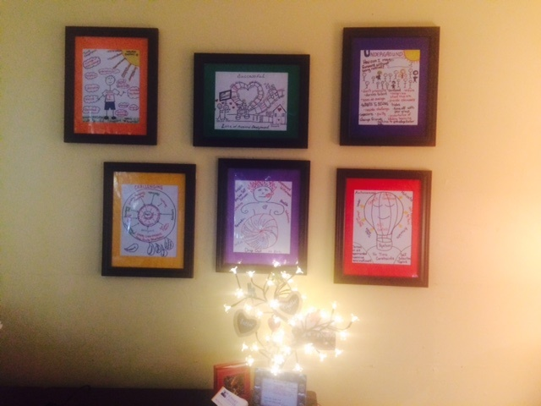
Profiles of Gifted Learners
The Ah-ha Moment!

Slide 15
2009
GATE Open House
Parents & teachers gathered and brainstormed -
“Hopes and Dreams for the Future of GATE.”
  No more “lottery losers”
  Get resources to classrooms
  More communication
  Standardize offerings so no confusion in transition from K-5 to 6-8 to 9-12

Slide 16

GATE Education Code 52200-52212
…develop unique educational opportunities for high-achieving and underachieving pupils…who have been identified as gifted and talented
…ensure pupils from economically disadvantaged and varying cultural backgrounds are provided full participation in these opportunities.
GATE curricular components are required to be planned and organized as integrated differentiated learning experiences within the school day.

Slide 17
Understanding what was?
What did NVUSD GATE provide pre-2009 ?
4th & 5th - After-school academies
(63 turned away)
6th- 8th - Varied
(advanced classes - open to all)
9th-12th - AP/ Honors (open to all)

Slide 18
Why was this confusing?
If a student were striving or struggling - nothing during the day? THEN opportunity after-school?
Should Accelerated learners “hang out” during the day because after-school classes await?
Wouldn’t ALL students benefit from enrichment? Is this GATE or simply good education for all?
Notes:
Thinking about my classroom

Slide 19
Back to Our District Vision
All students need access to intervention and support if needs not met
Every student should get what every student needs and keep moving forward

Slide 20
Outliers
As teachers we can meet the needs of about 80% of our students. When we have outliers at either end, we need to be flexible and ‘think outside the box’ to meet needs.
Notes:
Story about Alex

Slide 21
Identifying our Advanced Learning Outliers
In 2010 we began providing Universal Screening to all 1,300+ 3rd graders using the CogAT (Cognitive Abilities Test)
This has enabled us to
Raise awareness of our advanced outliers at each school site
Identify some of our Twice-Exceptional students that scored advanced in one area and average to below average in another area. (e.g. discrepancy between verbal and quantitative reasoning)

Slide 22
2011-Data Analysis Uncovers Inequities
In 2011-12 ALPS Identified 1,935 students
76.9% came from English at home families
23.1% came from Non-English at home families
It was evident that we were not equitably identifying English Learners for ALPS.

Slide 23

Collaboration between ELL Services and ALPS was established!
Phone Call to Riverside Publishing!
  Hot Topic
  Riverside recommendation
Met with Ivan Chaidez director of English Learner Services to get his input
Established a focus group of teachers to gather input on the identification process

Slide 24
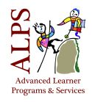
  The Research Journey began…
References for Changing English Learners
ALPS Qualification
  “Assessing Limited English Proficient Students for Eligibility for Gifted Programs”- Florida Technical Assistance Paper
  Catching Up or Leading the Way copy write 2009- Yong Zhao
  CDE-EL Institute 2009- “Changing the Face of Giftedness-Alternate Methods for Identifying English Learners” Santa Ana Unified School District
  Outliers- copy write 2008-Malcom Gladwell
  Teaching with Poverty in Mind copy write 2009-Eric Jensen
  Working with Gifted English Learners copy write 2006-Michael S. Matthews Ph.D.

Slide 25
Language Development and Academic Learning
J. Cummins (1991)
“While many children develop native speaker fluency with in two years of immersion in the target language, it takes 5-7 years for a child to be working on an academic level with native speakers.”
  BICS-Basic Interpersonal Communication Skills
Example-Conversational ability in another language
  CALPS- Cognitive Academic Linguistic Proficiency Skills
Example-Academic ability in another language

Slide 26
How do English Learners Qualify?
English proficiency levels are now considered along with a combination of CogAT, SRI (Scholastic Reading Inventory), SMI (Scholastic Math Inventory).
Details can be found at
www.nvusd.k12.ca.us/alps_identification

Slide 27
What system was our district already using for our Striving Student Outliers?
Response to Intervention!
RtI is a tiered services model, which means that instruction and any other necessary assistance is delivered at whatever level is needed. Teachers constantly evaluate all students on a regular basis to determine their educational needs. Response to Intervention provides a structured method for doing this.
Notes:
RTI seeks to prevent academic failure through early intervention, frequent progress measurement, and increasingly intensive research-based instructional interventions for children

Slide 28
A Paradigm Shift
Could this framework be used to look at ALL students?
Could we include “advanced learners” in our RTI model to catch ‘all’ ?
Could the RTI model also be used to help identify and support Twice Exceptional Students?
Doesn’t it make sense to look at ALL of our learners through a unified lens?

Slide 29
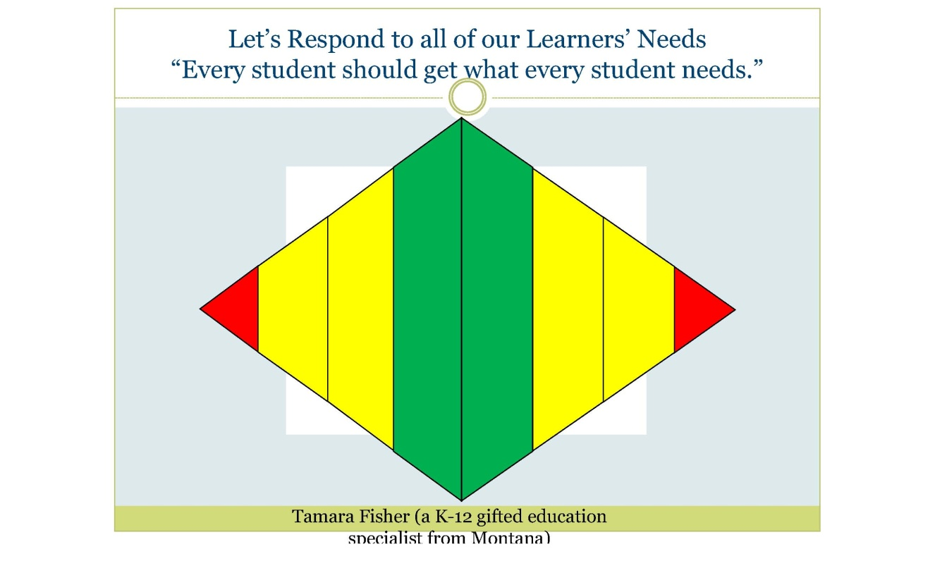
A Unified Pyramid-ALL Means ALL
TIER3
Student
Success Team
Grade Level
Acceleration,
Independent Study,
Barton, EDMARK
Individual Education Plan
Student Achievement
Pyramid of Interventions
How can we meet the needs of ALL learners within this framework?
TIER 2
Student Success Team
Interventions based on data,
ALPS Project Zone, Subject Level Acceleration, AP, Honors, Concurrent Enrollment, System 44,
Read 180 ,Behavior Support Plan, 504 Plan
TIER 1
Component of General Education for ALL
DIFFERENTIATION
NEEDS BASED INSTRUCTION/LEARNING
- Enhanced opportunities for extended learning for targeted students based on screening or formative assessments
Flexible grouping
Adapted from the Georgia Department of Education 2013
STANDARDS BASED CLASSROOM INSTRUCTION/LEARNING
Differentiated standards-based instruction
Progress monitoring/formative assessments/benchmarking data used to guide instruction
- Evidenced-based instructional strategies-IREAD

Slide 30
Our Mission
ALPS supports the educational needs of students who are academically gifted, academically highly gifted, and high achievers/ motivated learners. ALPS also works to support gifted Twice Exceptional students with learning challenges.
Using state-adopted curricula and focusing on student strengths, we assist teachers in providing differentiated, rigorous, and accelerated experiences during the school day. We also assist teachers and families in identifying resources for serving “multiple intelligences” and unique interests of students to encourage their passion for learning.
Notes:
When we focus on our strengths it helps us to overcome our challenges.

Slide 31
2015
Where we are we now?
Redefined G.A.T.E. as A.L.P.S:
(Advanced Learner Programs and Services)
No more lottery losers!
  Resources to classrooms
Improved communication:
  Paid Reps at each site
  Monthly Golden Nugget Trainings
  Tri-annual newsletter
  Website for teachers and parents
  http://www.nvusd.k12.ca.us/alps

Slide 32
2015
Where are we now?
K-12 Student Success Team Support
  Added to the District SST Process
  TOSA creates individualized plans for students
  Acceleration process in place
ALPS Project Zone
  Anyone who shows a need or interest can access
  Differentiation Coach (20%)
NVUSD Resources
  Choice Boards incorporating: Core materials, ALPS Project Zone, ST Math, Kahn Academy, Sumdog.com, etc…
  Systems and Strategies: Visual Thinking Strategies, PBL, AP, Honors, Accelerated Classes, Cluster-grouping, Depth and Complexity

Slide 33
2015
Where are we now?
Partnerships
  NVUSD Ed Foundation – $$ /ALPS summer school
  Napa Valley Writing Project
  Copperfields Book Store
  Johns Hopkins - 95 tested/45 qualified
  Napa Valley TV
  We Are/Somos Napa
  Summit Center
  Surfer Math
  Sylvan Learning Center
  Napa County Office of Education
Social-Emotional Needs:
  DVD’s by Dr. Dan Peters - Taming the Worry Monster and The Characteristics of Gifted Students - EVERY School

Slide 34

Let’s Respond to all of our Learners’ Needs
“Every student should get what every student needs.”
Tamara Fisher
(a K-12 gifted education specialist from Montana)

Slide 35
Still Growing – It’s About Learning!
"Celebrate what you’ve accomplished, but raise the bar a little higher each time you succeed."
— Mia Hamm

Slide 36
It takes a Village…
Thank you, NVUSD, for providing our district the opportunity to work with Dr. Susan Daniels and Sandy Simpson in our GATE Certification Course Training.
Thank you, NVUSD, for creating a GATE TOSA position to work with GATE trainers and GATE DAC to start the process of redefining how NVUSD provides Gifted Education.
Thank you , Sandy Simpson, for sharing her vision of GATE as (ALPS) Advanced Learner Programs and Services and allowing us to make it a part of our NVUSD GATE program.
Thank you to Dr. Dan Peters for helping us to understand the needs of twice-exceptional students and providing us with resources to support the social-emotional needs of gifted students.
Thank you, Georgia Department of Education, for sharing a model on how to use RTI to address the needs of advanced learners.
Thank you, Tamara Fisher (a K-12 gifted education specialist from Montana), who created the idea of a double pyramid icon to reflect the needs of all of our learners.

